Slide 1




ABC Call Volume Trend Analysis

Slide 2

Description
Table of Content:
Approach
Tech-Stack Used Insights
Result

Slide 3

Understanding
Data
Visualizing data
Cleaning Data
Approach
Analyzing data

Slide 4



Tech-stack Used:
[Microsoft Excel 2016]
-to clean, analyze and
visualize the data
[Microsoft Power-Point]
-to make a report

Slide 5
Data Understanding
Duplicate Values 0
Number Of Rows 1,17,989
Number of Columns 13
Null Values
Abnormal Value (#N/A)
Wrapped by 47,877
Agent Name 34,198
Agent ID 34,198

Slide 6
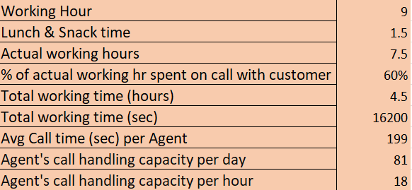
Assumptions

Slide 7

Analysis & Visualization

Slide 8
1) Average Call Duration
Task 1): What is the average duration of calls for each time bucket?
Insight:The highest average call duration is from 4pm to 9pm and least between 12am
to2pm.

Slide 9
2)Call Volume Analysis
Task 2): Can you create a chart or graph that shows the number of calls received in each time bucket?
Insight: From the below chart we can observe that the highest call received
from customer are in the 10am-2pm time bucket.

Slide 10
Task 3)Manpower Day Planning
Task: What is the minimum number of agents required in each time bucket to reduce the abandon rate to 10%?
Insight: The graph shows that the call abandonment rate by time bucket, and patterns shows
that the abandon rate is highest at the beginning and end of the day shift.

Slide 11
Task 4)Night Shift Planning
Task: Propose a manpower plan for each time bucket throughout the day, keeping the maximum abandon rate at 10%.
Insight: For every 100 calls that customer make between 9am to 9pm ,they also make 30 calls at night between 9pm-9am. So, more number of agents are required to reduce Abandon rate to 10%

Slide 12
Insights
The overall average call duration is 199 seconds. The highest call duration is observed during the 4 PM to 9 PM time slot, with an average of 203 seconds.
The lowest call durations are noted between 12 AM to 2 PM, which indicates a lighter load or less complex issues during these hours.
To reduce the abandon rate to 10% it’s a good idea to adjust agent schedules by adding staff in the morning to afternoon shift (9am-2pm).. If needed, hiring additional agents to cover busy times could help. Using flexible work schedules could also ensure enough staff are available when demand is highest.
Overall High demand periods are necessary for additional manpower. Proper shift adjustments and staff allocation can help reduce abandonment rates and improve overall efficiency.

Slide 13
Result
Excel Sheet Hyper Link
This project was challenging and has helped me to enhance my skills in Excel usage, comfortability around it, data analysis and visualization.
Skill learned: problem-solving and manpower planning.
Overall, this project enhanced my Excel skills for data analysis, equipping me with the ability to extract meaningful insights , make informed decisions and contribute to better outcomes.

Slide 14

Thank you!
Project made by – Sravani Ginamoni

